Slide 1
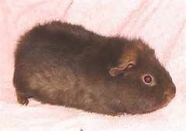
Today 10/09/14 period 1
Attendance / seating chart
Say hi to MR. BEAN : )
Notes on Density
Worksheet
Begin Lab if time??
Lat /Long
Time Zones
Contour maps

Slide 2
Today 10/9/14 period 7
Attendance/Seating Chart
Say Hi to Mr. Bean!
Check and go over Density HW
More Notes
Another worksheet
Lab folder fun – if time
Lat /Long
Time Zones
Contour maps

Slide 3
Unit 1 Intro and Topographic Maps
Measuring the Earth

Slide 4
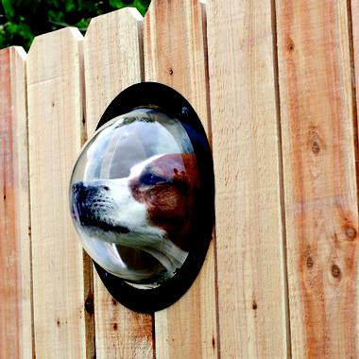
Using your senses is called:
Observation

Slide 5

An assumption made on observations is called an
Inference

Slide 6
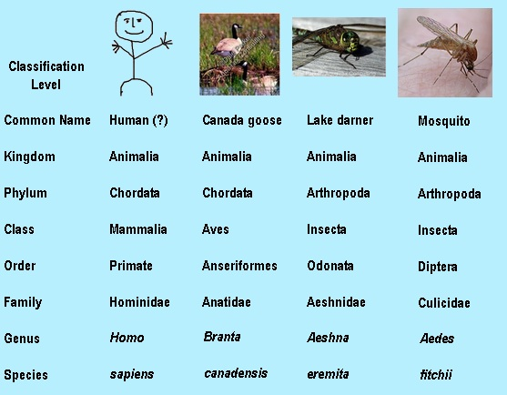
Grouping according to common characteristics is called
Classification

Slide 7
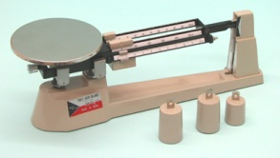
Mass is measured with a balance.

Slide 8
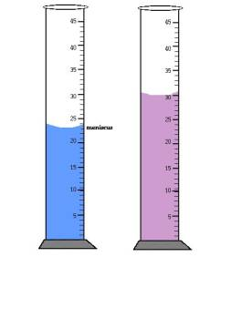
Volume is measured with a graduated cylinder.

Slide 9
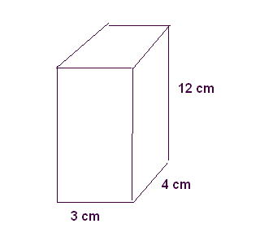
What is the volume of this?

Slide 10
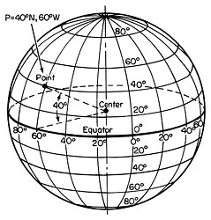
The science of determining your position on Earth is called:
Navigation

Slide 11
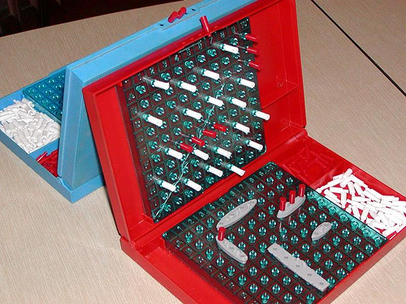
Coordinate Systems use two points to show location.

Slide 12
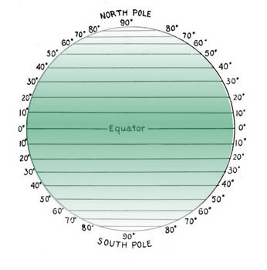
These are lines of…?
Latitude

Slide 13

Latitude is based on the
altitude of Polaris
Polaris
angle
Horizon

Slide 14
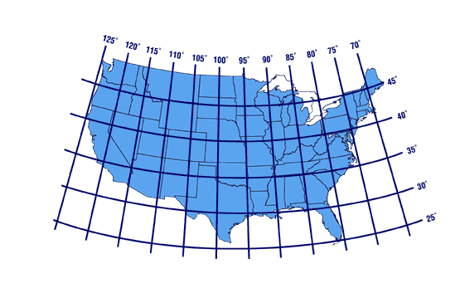
As a person travels FROM Florida TO New York, the latitude . Therefore, the altitude of Polaris .
increases
increases

Slide 15
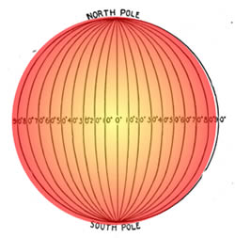
These are lines of…?
Longitude

Slide 16
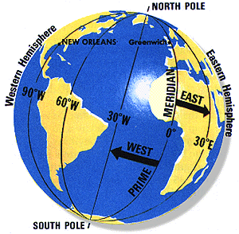

Longitude—
Meridians that run from the North Pole to the South Pole and measure W-E of the Prime Meridian
Notes:
If we know that the Earth rotates at 15 degrees per hour, can we determine how many time zones are around the world?
How many degrees are in a circle?
How long does it take in hours, for the Earth to rotate once on its axis? (hence, make a circle)
Show math below:
If we travel west (towards California), are they ahead or behind us?
If we travel east (towards France), are they ahead or behind us?
If we traveled south (towards Florida), are they ahead or behind us?

Slide 17
Breaking it down…
Both latitude and longitude are broken down into smaller units called degrees
Degrees are broken down into smaller units called minutes. There are 60 minutes in one degree.
Lat & Long ALWAYS are followed by a compass direction.
Ex: 42°30’N and 77°45’W

Slide 18
17°N
16°N
15°N
Using a BLUE colored pencil, draw the 16°30’N line.
Using a RED colored pencil, draw the 16°15’N line.
Using a GREEN colored pencil, draw the 16°45’N line.

Slide 19
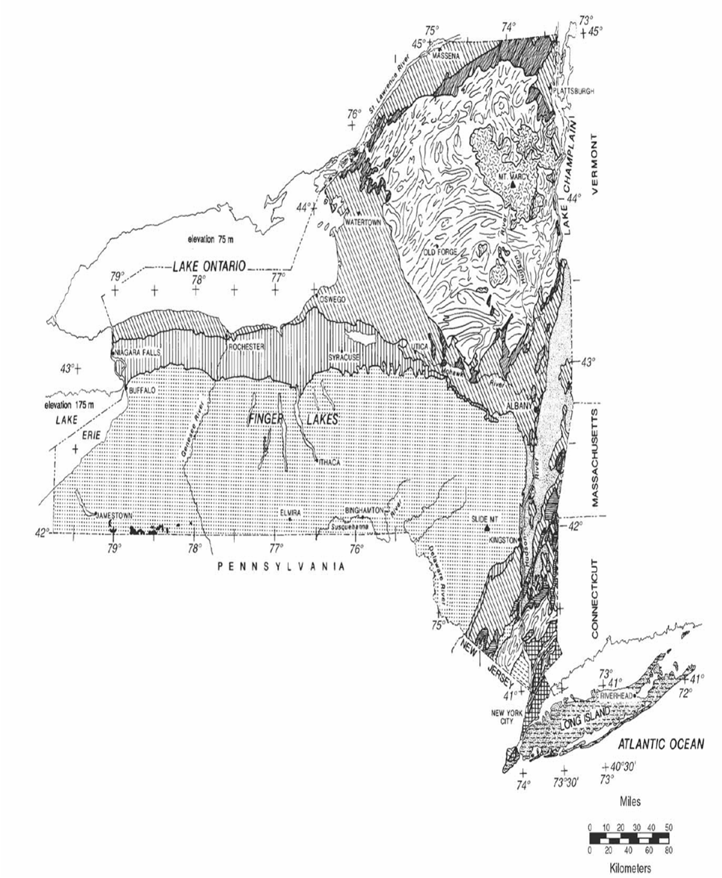

Slide 20
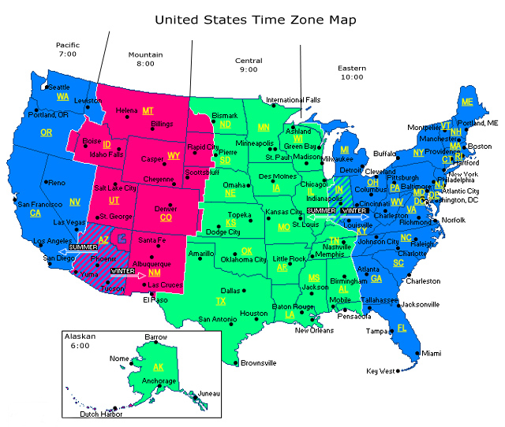

Slide 21
How many time zones are there on Earth?
24

Slide 22
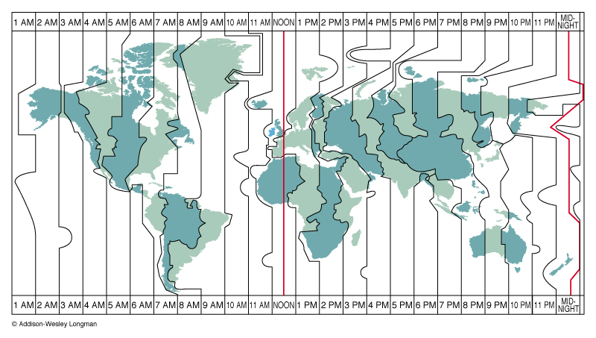
What are time zones based on?
Longitude

Slide 23
If you move one time zone to the East, time will be one hour ___?
one
hour
later

Slide 24
So the opposite must be true.
one
hour
earlier

Slide 25
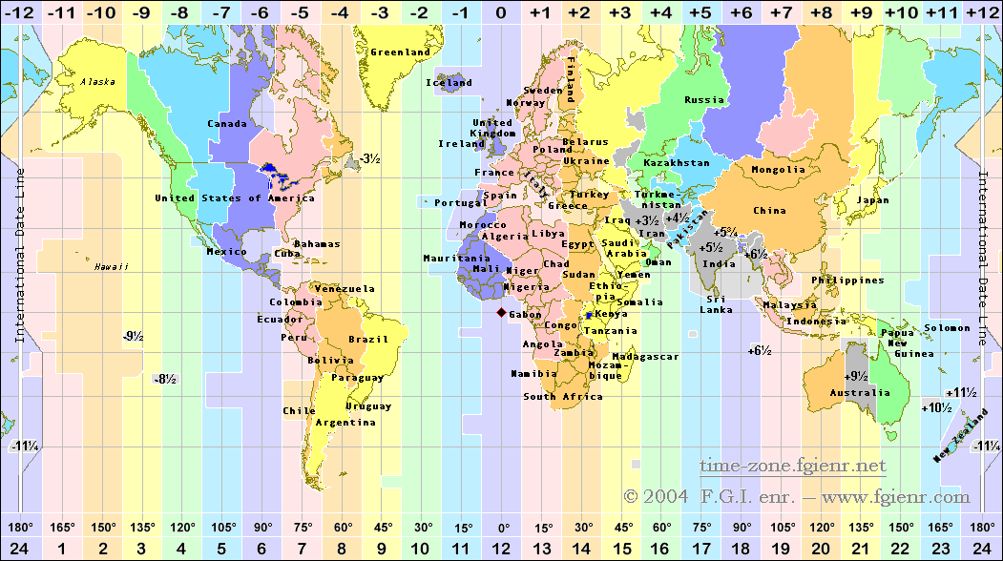

Slide 26
A region of space in which a similar quantity can be measured is called the __.
Field

Slide 27
Now where?
   
40 40 20 15
   
30 50 50 40 25
   
30 40 35 20
   
40 40 20 15
   
30 50 50 40 25
   
30 40 35 20

Slide 28
Isolines—
Lines that connect equal values on a field map
   
10 20 10 0
  
10 20 20 10
   
10 10 10 0

Slide 29
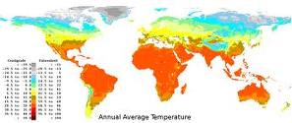
What ever is measured on the map is called the Field.
These are
called
Isotherms

Slide 30
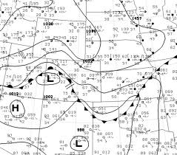
Air pressure
Isobars

Slide 31
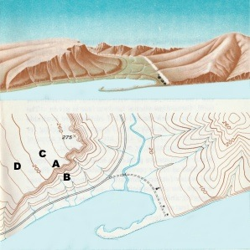
Elevation
Contour Lines

Slide 32
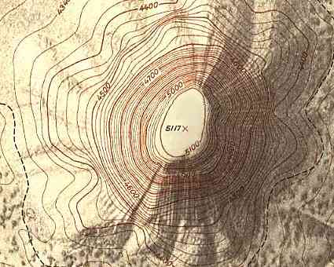
Topographic maps are also called…
Contour Maps

Slide 33
The distance between contour lines is called the …
Contour interval

Slide 34
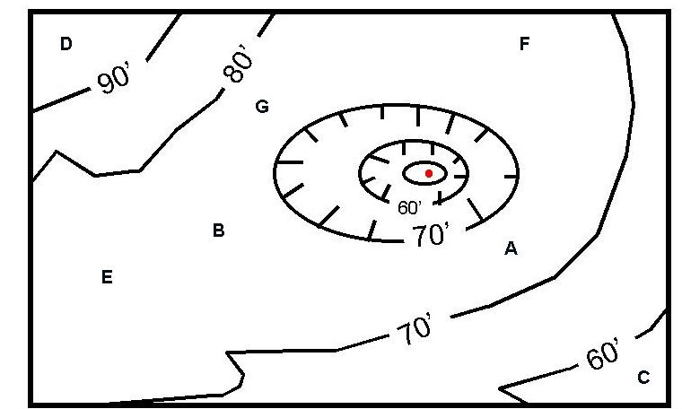
What is the contour interval?
10 feet

Slide 35
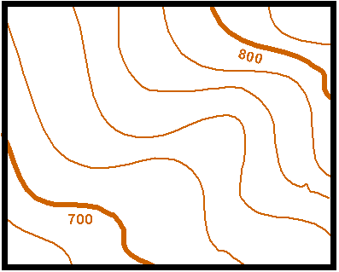
All points on the same line have the same ________________.
elevation

Slide 36
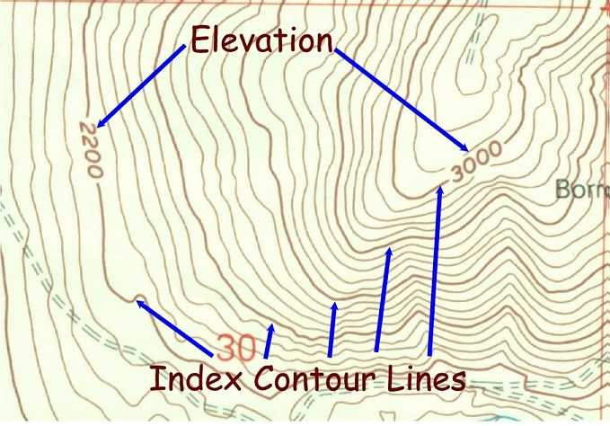
Every 5th line there is a darker line called the ______ line.
index

Slide 37
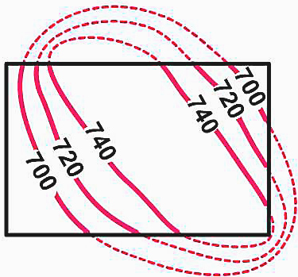
All contour lines are ___________.
closed

Slide 38
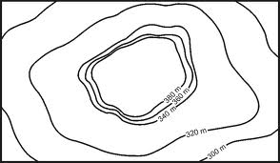
Look at how close the lines are!
Gentle
Steep
Notes:
On a contour map how can you tell, without doing any calculations, if there is a steep or gentle slope of the land?

Slide 39
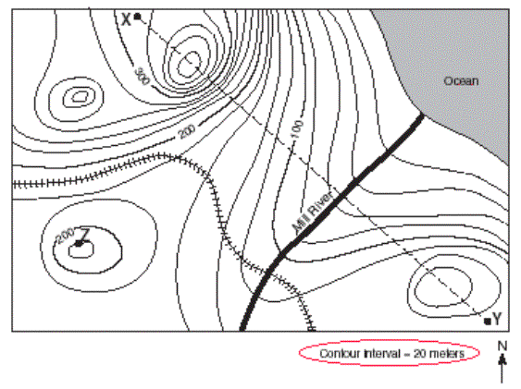
Stream Flow…How can you determine the direction that a stream flows?
Water flows
DOWN HILL
Contour lines point uphill

Slide 40
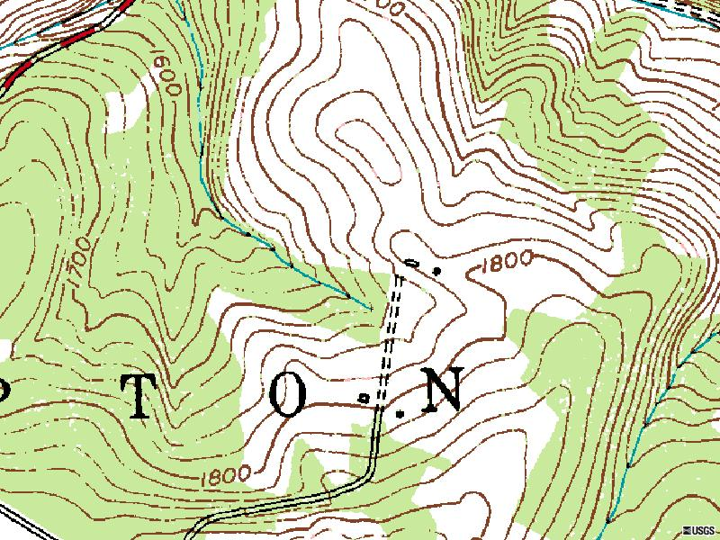
Contour lines point uphill when crossing a river & river flows downhill (opposite direction)

Slide 41
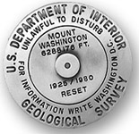
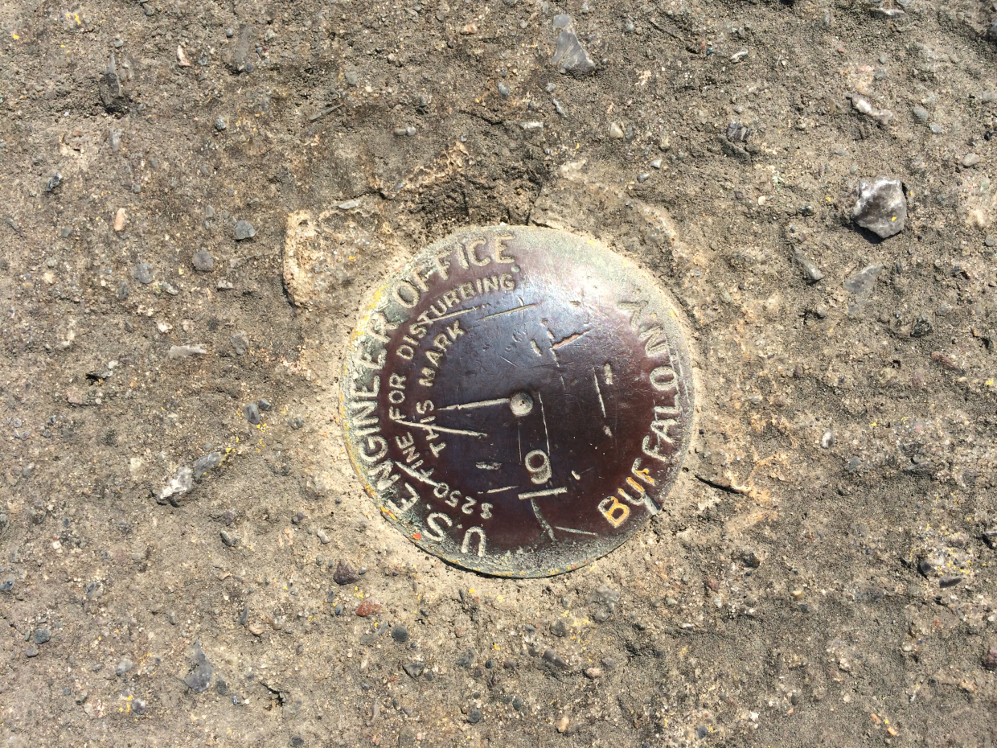
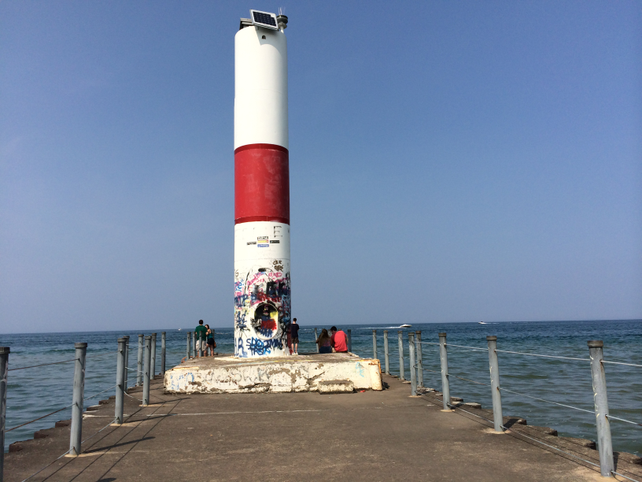
Benchmark—
A place where the elevation has been measured and a marker has been placed.
Notes:
This benchmark is on the pier at Charlotte.

Slide 42
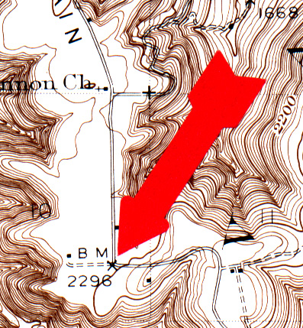
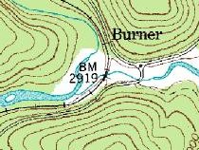
Represented on a topographic map with a BM followed by a number

Slide 43
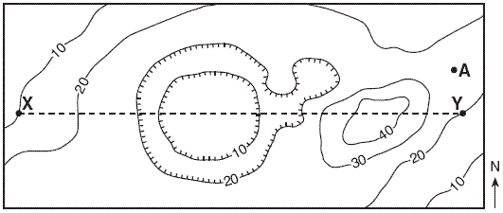
Hills vs. Depressions…How can you tell the difference?
Hill
decrease
Depressions show a in elevation and have on them.
Hills show an in elevation.
hachure lines
increase

Slide 44
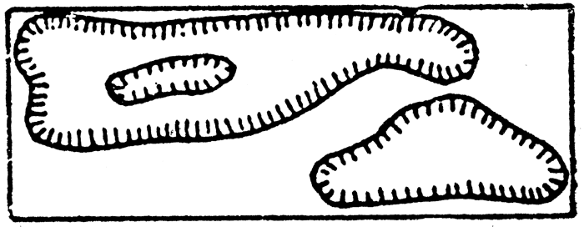
Depressions have hachure lines.

Slide 45
Rules for depressions:
The first depression contour is the same elevation as the lowest regular contour line before it.
The second depression contour (and so forth) is where the elevation DECREASES by the contour interval.

Slide 46
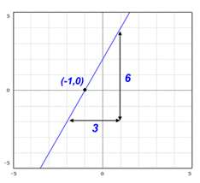
Slope

Slide 47
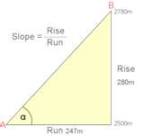
Slope

Slide 48
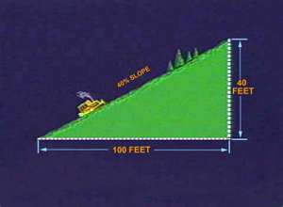
Gradient = slope

Slide 49
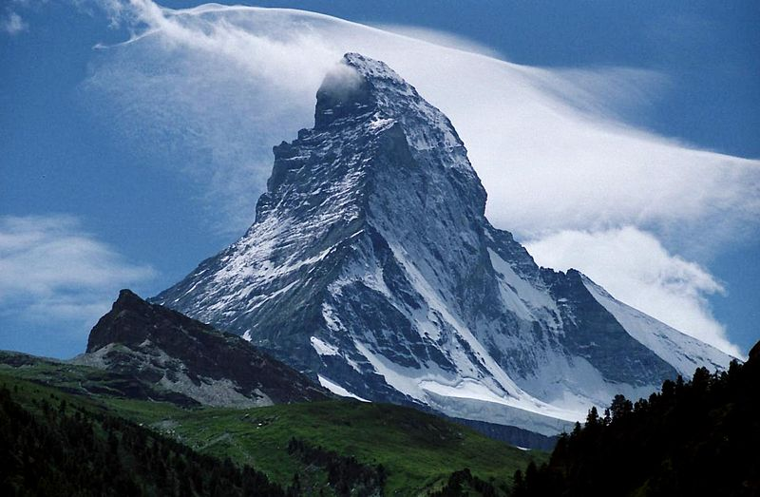
Gradient

Slide 50
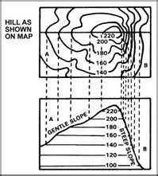
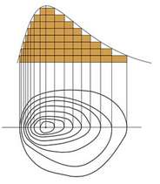
Profile: what it looks like from the side.

Slide 51
Need practice drawing a profile?
http://www.tasagraphicarts.com/activities/profile.html

Slide 52
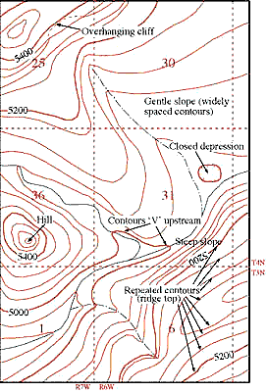

Slide 53
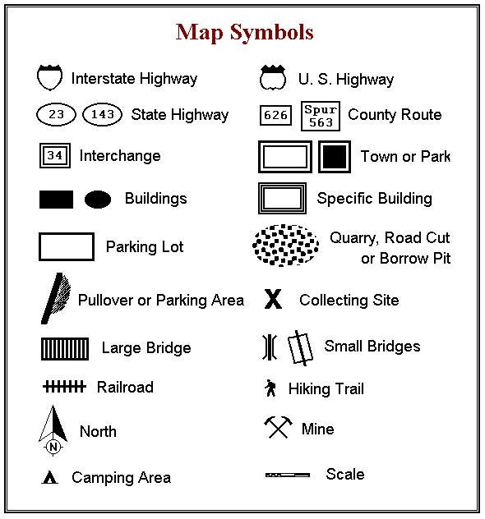

Slide 54
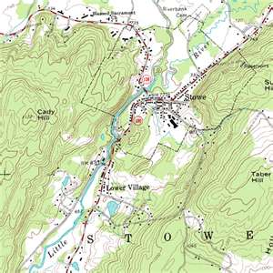
A real topographic map.

Slide 55
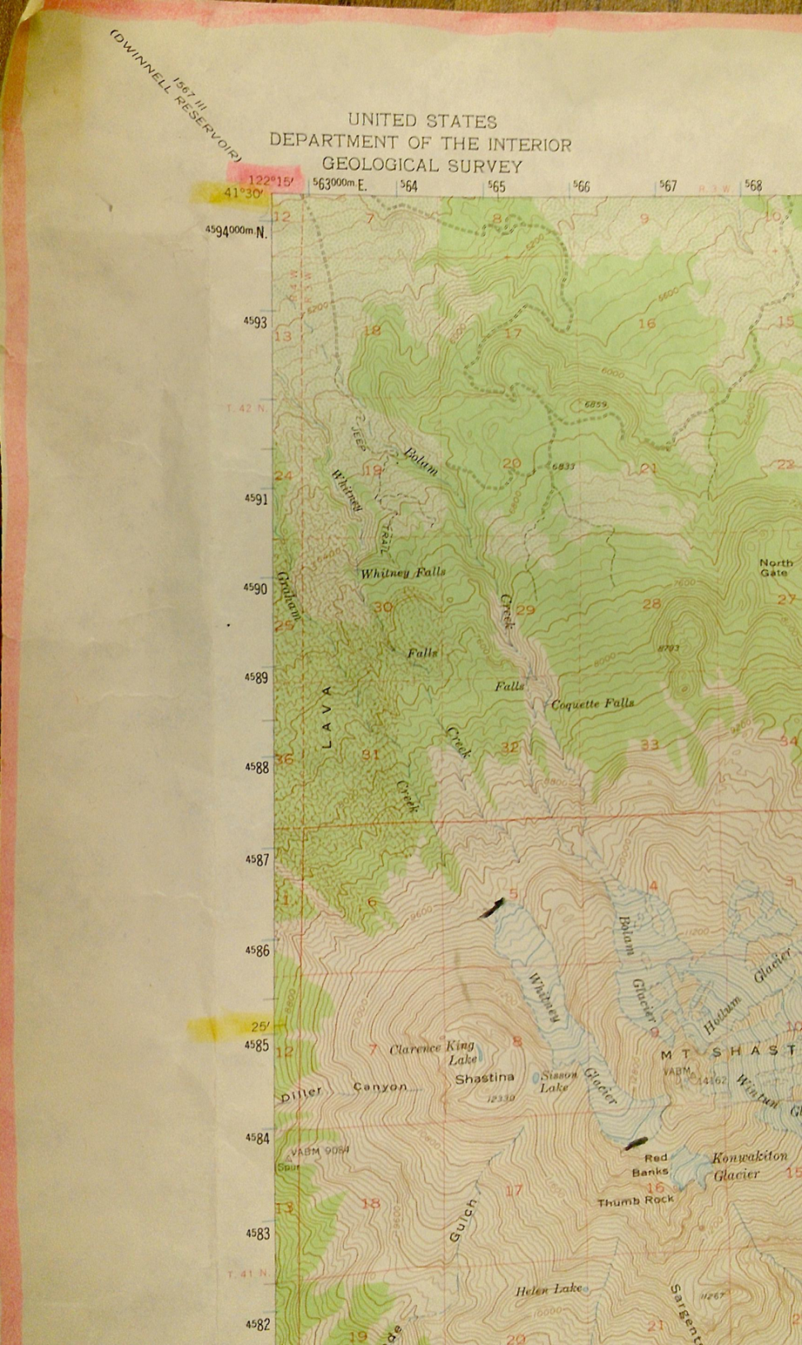
Longitude is in pink. Latitude is in yellow.

Slide 56
